Slide 1
Flex - Intan Adapter Board v2
Documentation v2
John Hermiz
04/20/17

Slide 2
Overview
The objective of this document is detail the analog to software channel mapping and the switch functionality and mapping.

Slide 3
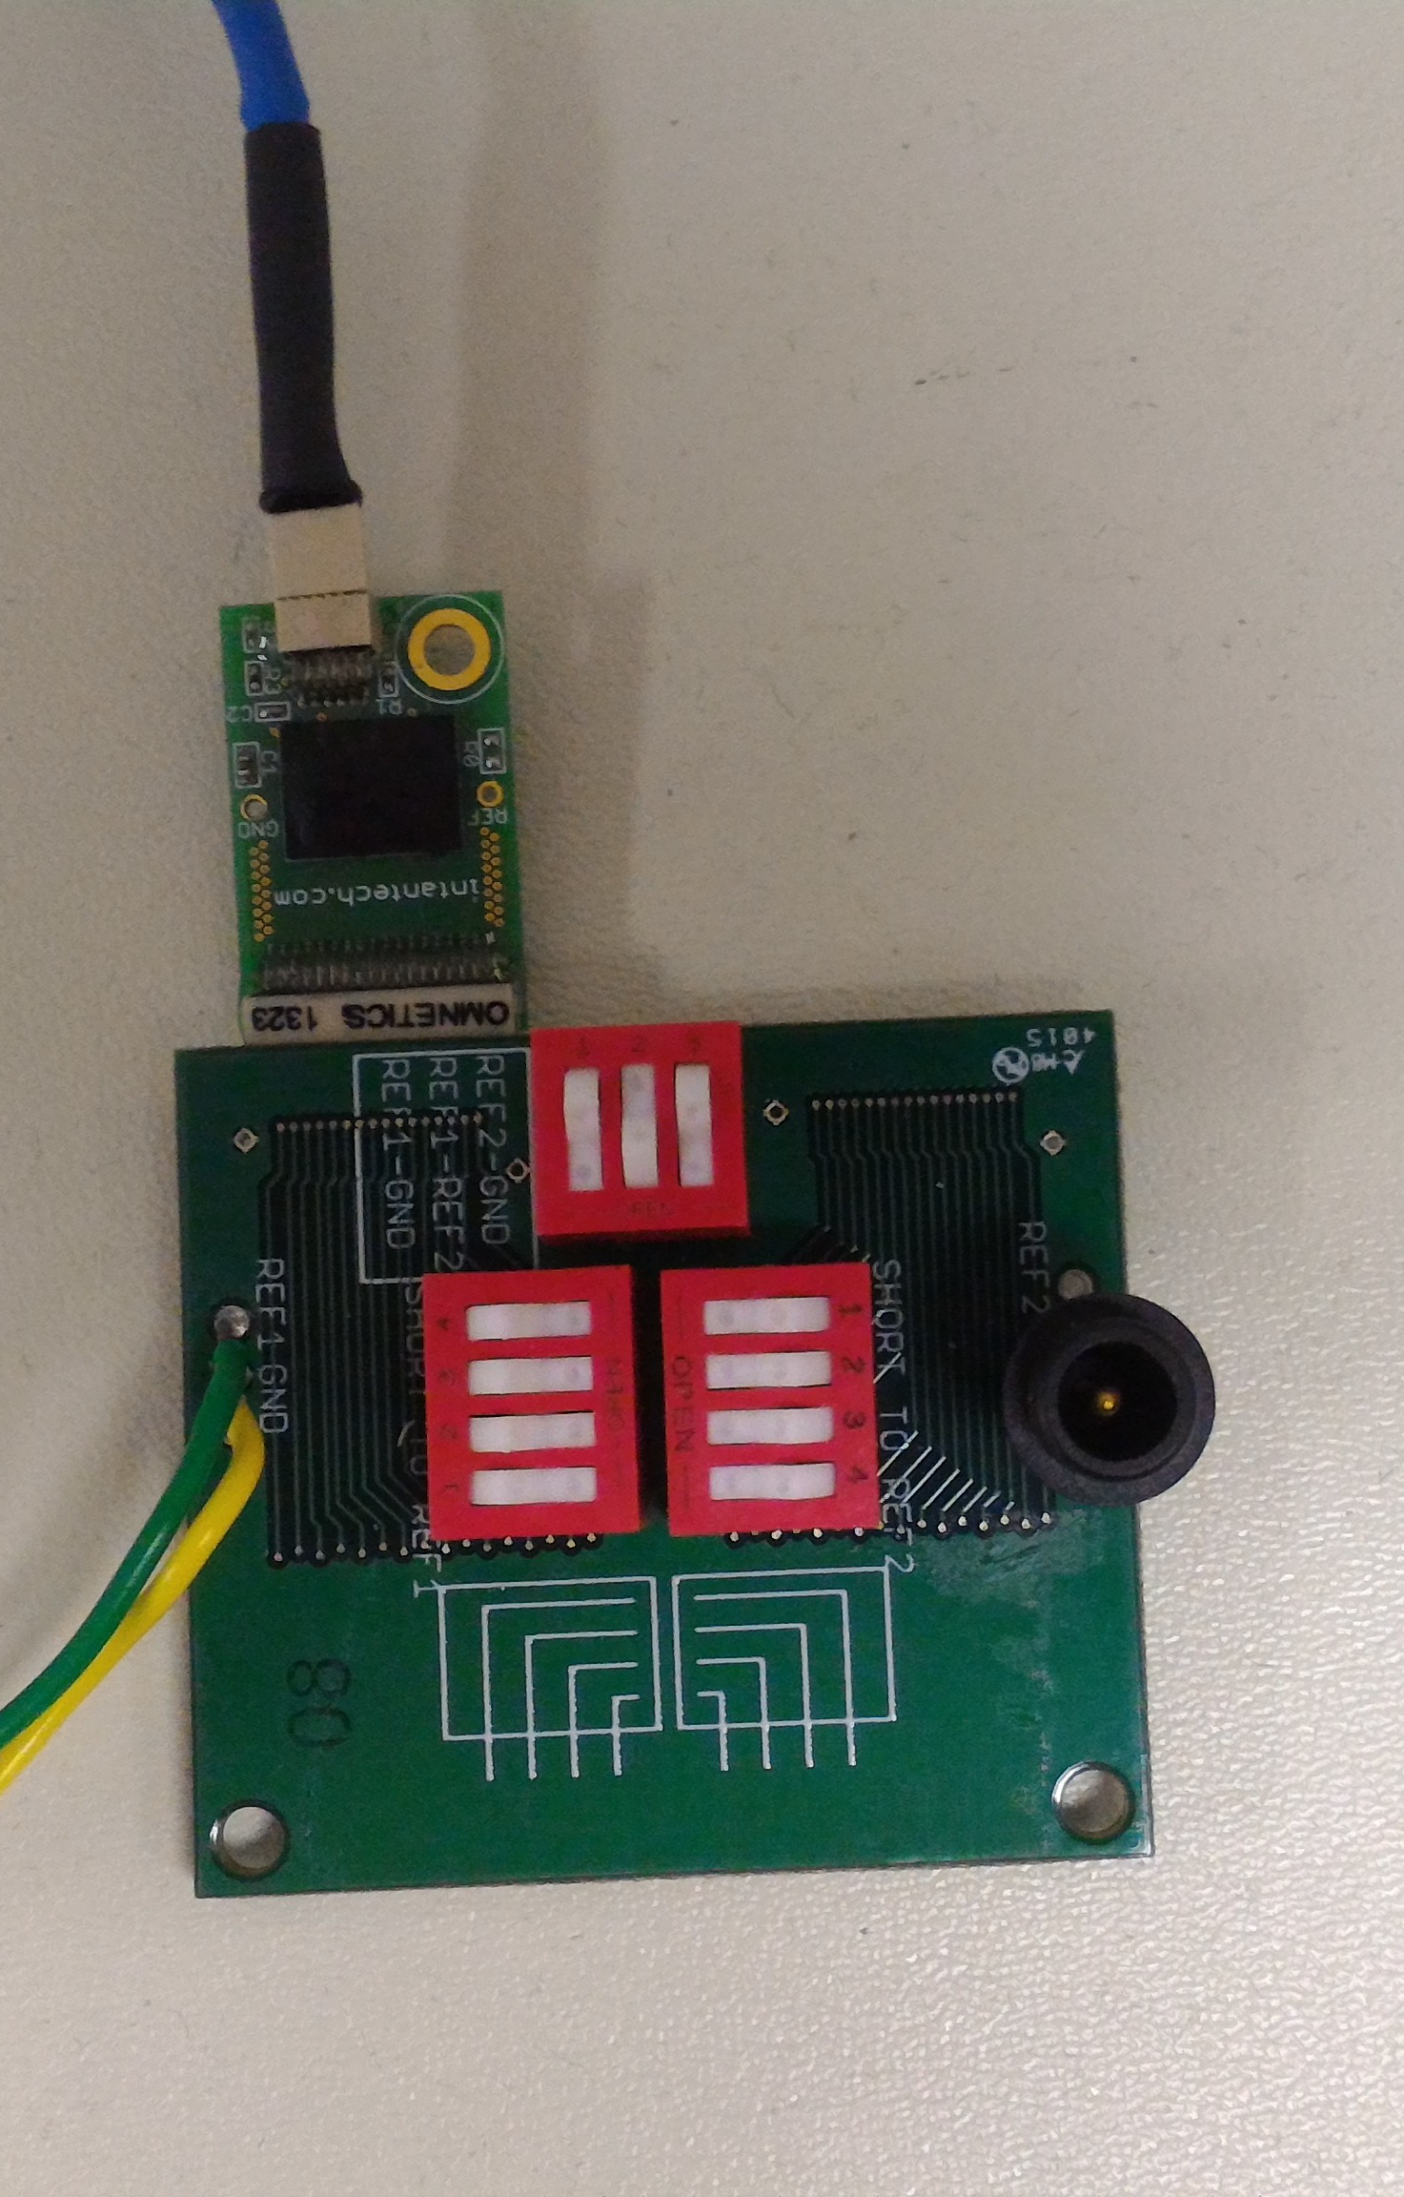
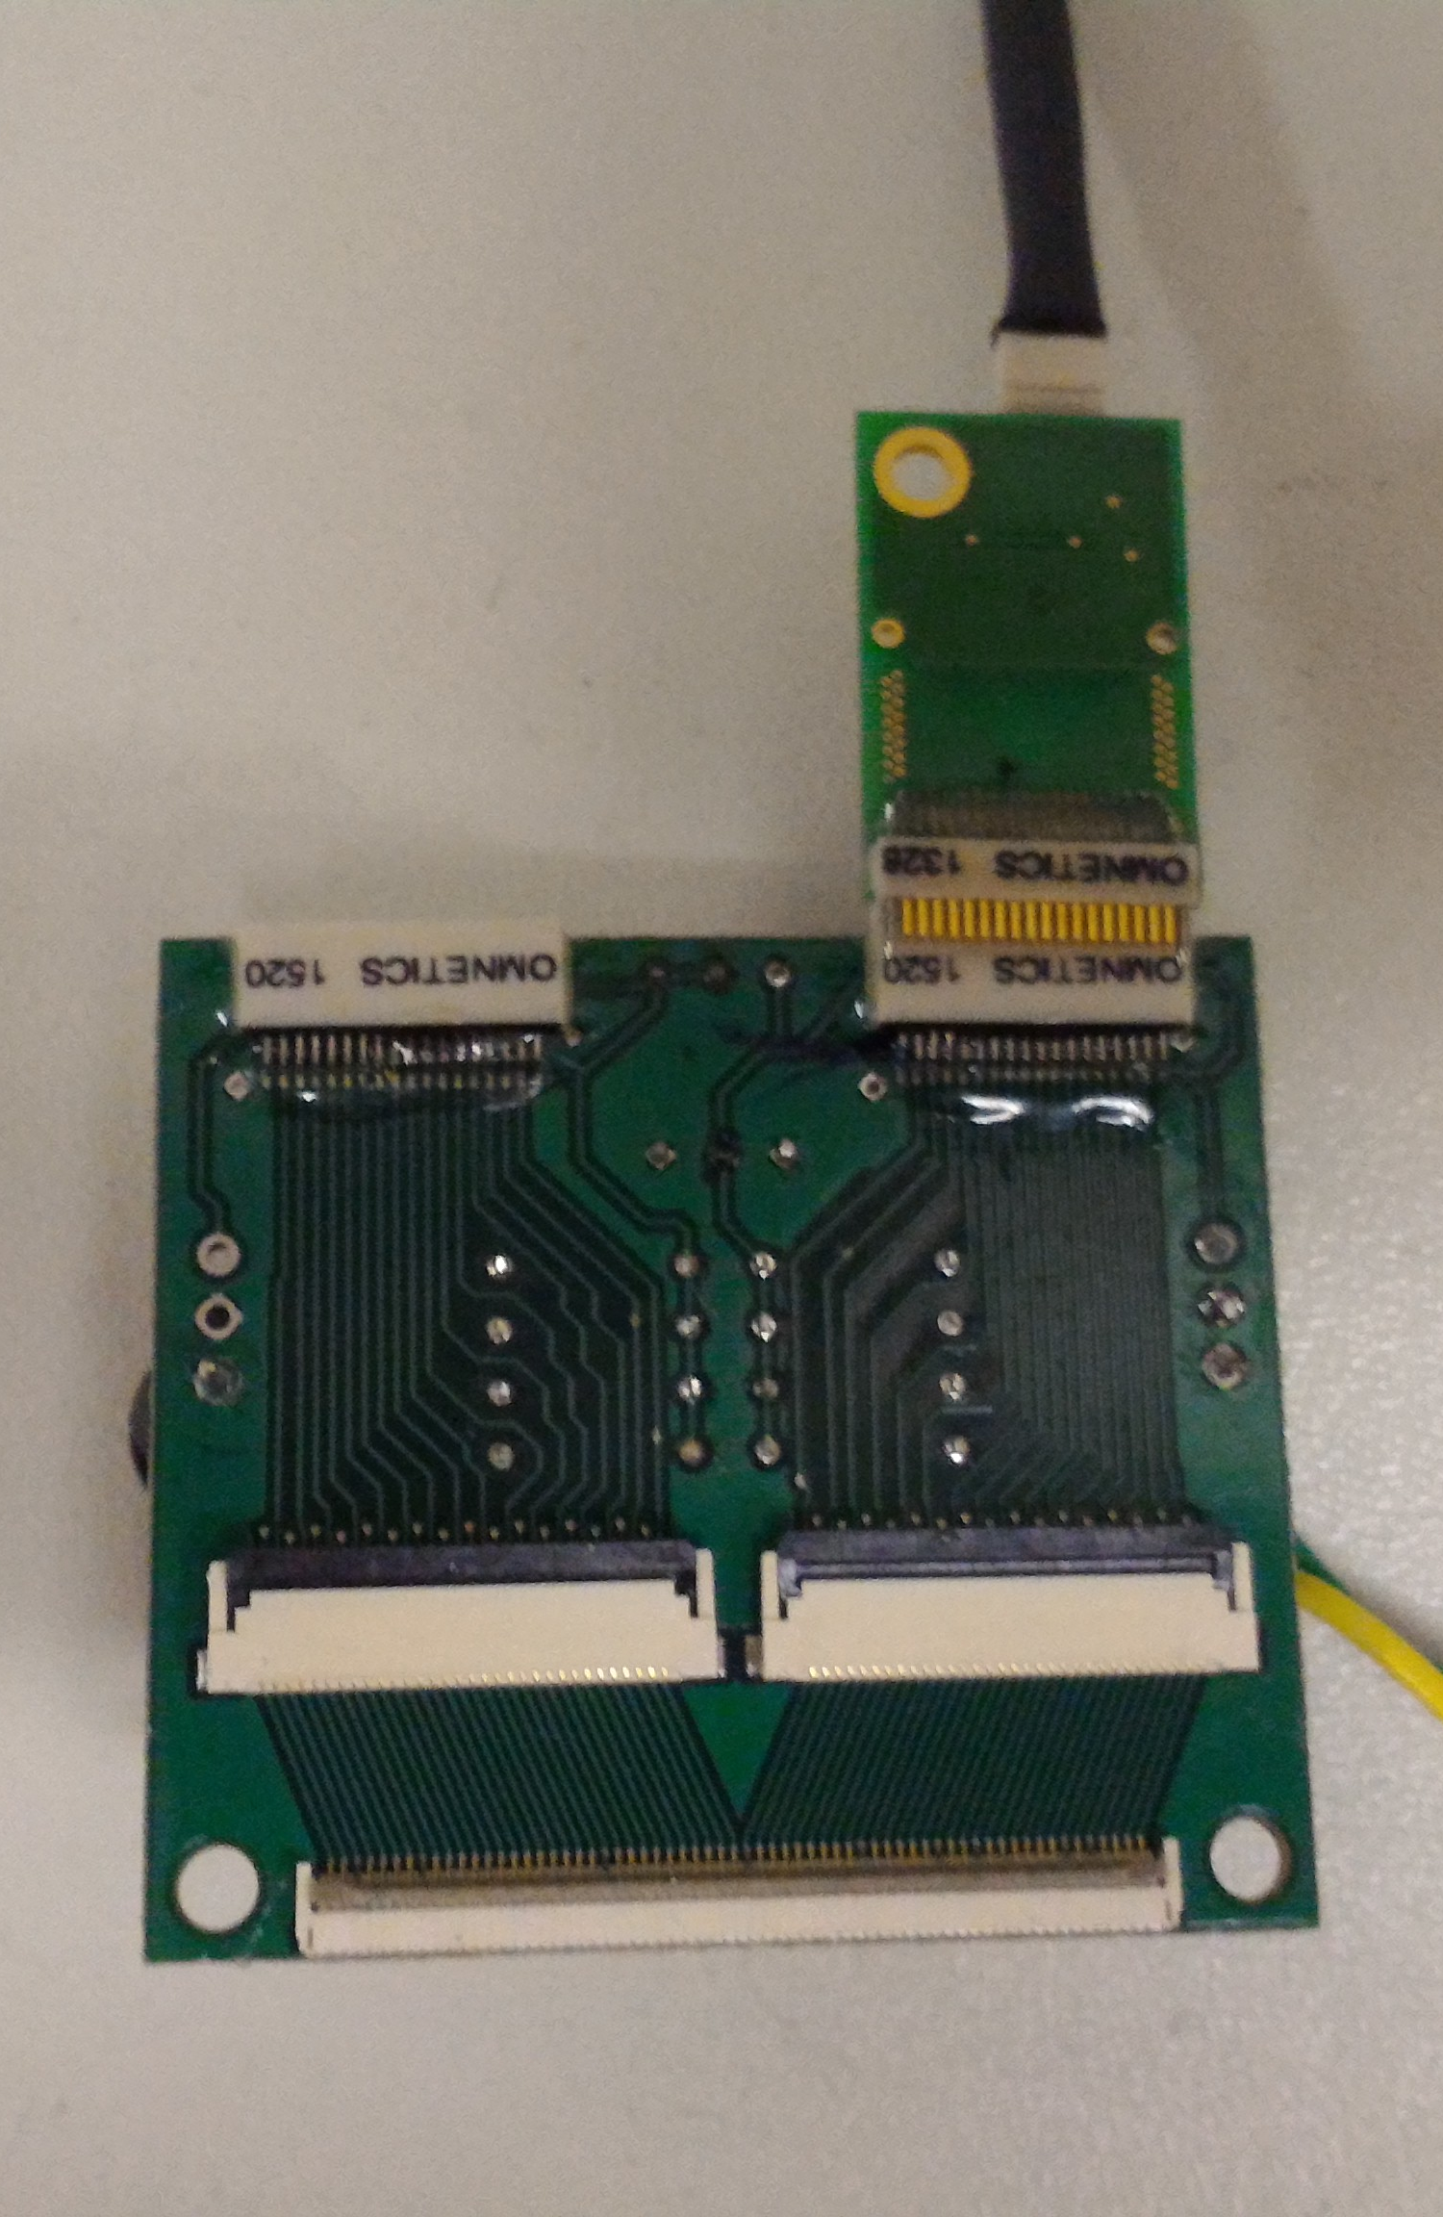
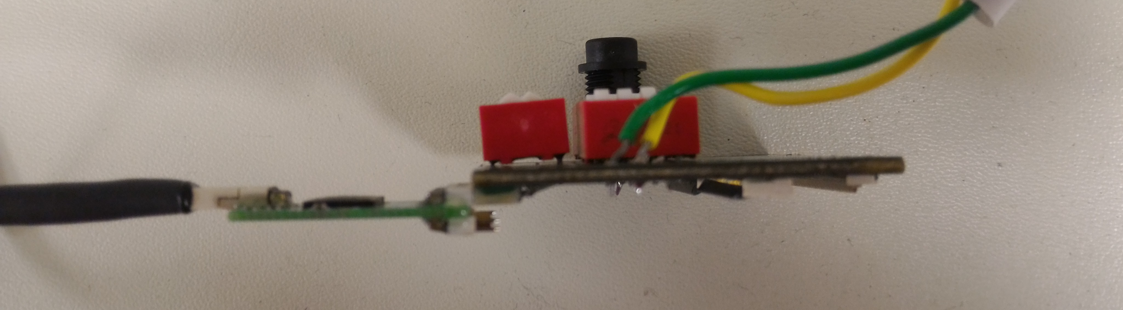
Front Side
Back Side
Intan Amplifier
64 chan
Switches
Ref and Gnd Connections
32 chan Flex Connectors
64 chan Flex Connector
Side View
Front Side
Back Side

Slide 4
Channel Map
Intan 1 is connected to Port 1
Intan 2 is connected to Port 2
Port 1 and Port 2 is connected to Port 3
Note: If you use a Intan amplifier with 64 channels, then 32 channels with be unconnected since Intan 1 & 2 only accept 32 channels
Ensure Intan Amplifiers are plugged in so that the extra pins are exposed on the back side of the board (as below)!
If the Intan Amplifier is plugged in the other way, then the channel map in the next slide will be wrong!
Intan 2
Intan 1
1,2, … 31,32
1,2, … 31,32
Port 1
Port 2
Side View
1,2, … 63,64
Chip Side
Front Side
Port 3
Back Side
Unconnected pins

Slide 5
Channel Map
Port 1 | Port 2 | Port 3 | Channel Name
1 | - | 1 | 16
2 | - | 2 | 17
. | - | . | .
31 | - | 31 | 46
32 | - | 32 | 47
- | 1 | 33 | 17
- | 2 | 34 | 16
- | . | . | .
- | 31 | 63 | 47
- | 32 | 64 | 46
“Channel Name” corresponds to the software channel name.
Bold & Italicized numbers (eg. 16) corresponds to the amplifier on Intan 1
Normal number (eg. 16) corresponds to amplifier on Intan 2
For full channel map, see “channel_map_spreadsheet.xlsx”
Intan 2
Intan 1
1,2, … 31,32
1,2, … 31,32
Port 1
Port 2
1,2, … 63,64
Port 3

Slide 6
Switches
The switches are used to have the flexibility to short ref and gnd as well as ref to channels
There are two refs on the board: ref1 and ref2 for each Intan amp that’s connected (there’s an option to short ref1 and ref2)
Typically, we leave ref and gnd as separate nodes (switch is open)
Typically, we short 2-4 channels to ref.
Deciding which channels to short depends on which configuration appears to eliminate noise the most

Slide 7
Switches
Front Side
Ref/Gnd: Group A
Switch | Function
1 (Left) | Ref 1 = GND
2 (Middle) | Ref 1 = Ref 2
3 (Right) | Ref 2 = GND
Note: The board has 2 references nodes:
Ref 1 (left side of board)
Ref 2 (right side of board)
Ref/Gnd
Group A
Ref/Gnd: Group B_{L}
Ref/Gnd: Group B_{R}
Switch | Function
1 (Bottom) | Ref 1 = 17
2 (Bottom Mid) | Ref 1 = 16
3 (Top Mid) | Ref 1 = 19
4 (Top) | Ref 1 = 18
Switch | Function
1 (Top) | Ref 2 = 44
2 (Top Mid) | Ref 2 = 45
3 (Bottom Mid) | Ref 2 = 46
4 (Bottom) | Ref 2 = 47
Ref/Channel
Group B_{R}
Ref/Channel
Group B_{L}

Slide 8
Switches
Front Side
Standard configuration switches prior to surgery:
Ref/Gnd: Group A
Ref/Gnd
Group A
Switch | Position
1 (Left) | Open
2 (Middle) | Close
3 (Right) | Open
Closed switches are highlighted in orange in the figure to the right
Ref/Channel
Group B_{R}
Ref/Gnd: Group B_{L}
Ref/Gnd: Group B_{R}
Ref/Channel
Group B_{L}
Switch | Position
1 (Bottom) | Close
2 (Bottom Mid) | Open or Close
3 (Top Mid) | Open
4 (Top) | Open
Switch | Position
1 (Top) | Open
2 (Top Mid) | Open
3 (Bottom Mid) | Open or Close
4 (Bottom) | Close

Slide 9
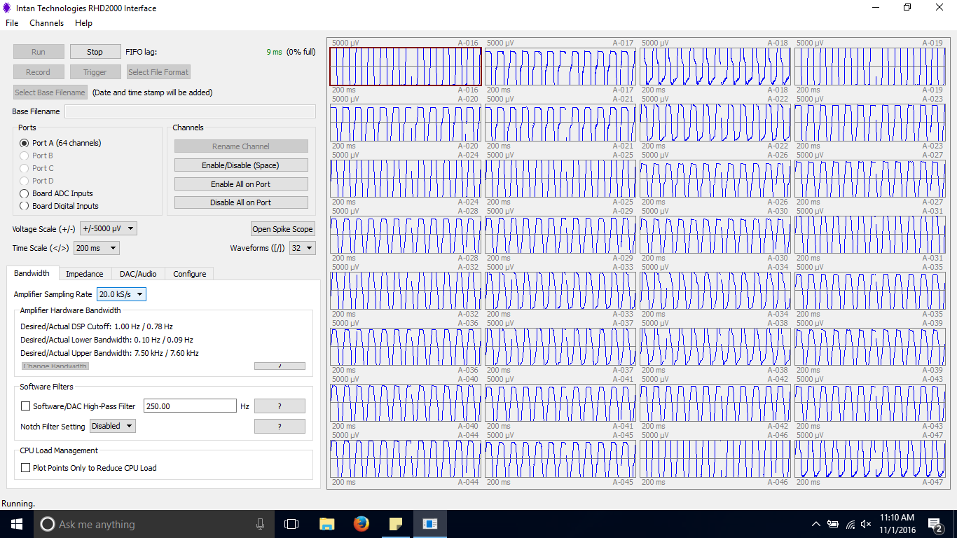
Software Interface
Channel Name

